Slide 1
dATA acquisition
Blake Rohde, Joel Tanzi, Michael Albert

Slide 2
Project WiMDAS
Wireless Modular Data Acquisition System

Slide 3
Project Features
Project WiMDAS
Modular, abstracted design
  USB or Ethernet-connected devices/microcontrollers interface to external protocols
    E.g. CAN, SPI, I2C, Serial, GPIO, etc.
SD Card-based storage
Real-time web interface for live-race analysis
Utilities for exporting data into existing, mature data analysis products for post-race analysis
  E.g. GDA's GEMS, MoTeC's i2, etc.

Slide 4
Objectives Breakdown
Project WiMDAS
Vehicle Host (V-Host)
  Intercept/capture all communications
    PCM-required (“primary”) sensors via CAN buses
    PCM output to sub-systems, debug messages
    “Secondary” sensors, e.g. GPS
  Relay all input wirelessly to R-Host
  Develop efficient storage, communication protocols
    Microcontroller-to-VHost data transmission
    Vhost-to-RHost wireless data transmission
    Data storage protocol
Remote Host (R-Host)
  Retrieve and capture/store all V-Host transmissions
  Host LAN/WiFi-accessable real-time web interface
    Preset and user-configurable panels
    Continuous, pause-able, zoom-able graphs for time-sensitive metrics
    Message panel for threshold alerts, debug messages

Slide 5
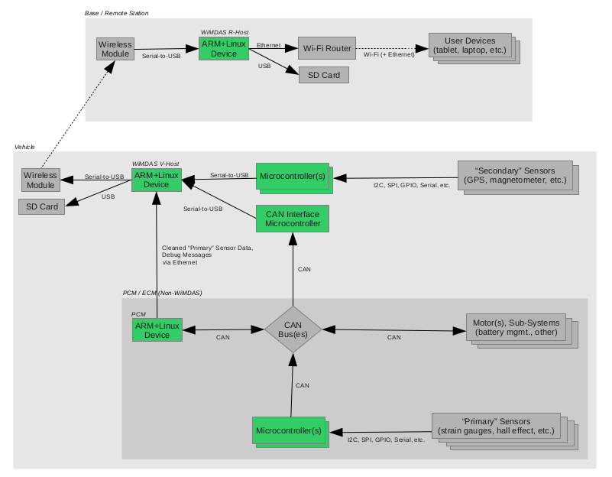
System Block Diagram
Project WiMDAS

Slide 7
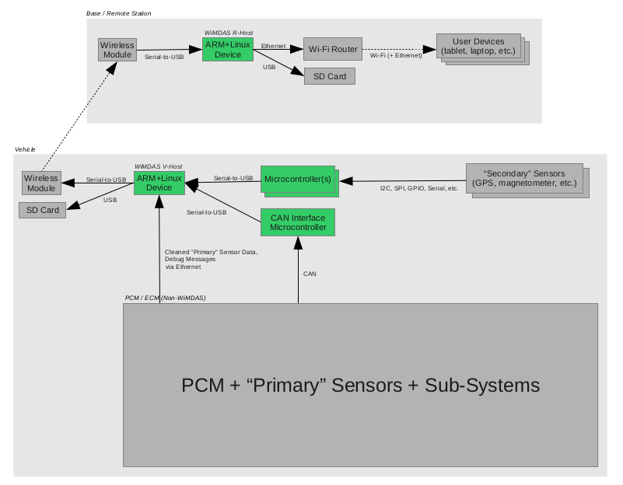

Slide 8
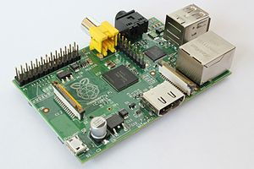
Hardware Breakdown
Project WiMDAS
“ARM+Linux Device”
  Raspberry Pi
    700 MHz ARM11, 256 MB RAM
    10/100 Ethernet, USB
    Composite RCA & HDMI Video
  USB SD Card R/W’er
“CAN Interface Microcontroller”
  Arduino Mega2560
  SparkFun CAN-BUS Shield
“Microcontroller”
  Arduino Mega2560
“Wireless Module”
  Ubiquiti Networks airMAX Bullet M
    10/100 Ethernet interface, 100+ Mbps (12.5 MB/s), 50+ km (31+ mi)
Source: Wikimedia (jwrodgers)

Slide 9
Schedule
Project WiMDAS
December 1, 2012
  Vehicle Host (V-Host) completed
    Capture all sensory data
      Inc. Microcontroller interfaces to sensors
    Data converter utility
Febuary 1, 2013
  Remote Host (R-Host) completed
    Wireless
    Real-time web interface
Free-time Bonuses
  Vehicle steering wheel display
  Video stream
  ???
  PROFIT!!!

